Slide 1
R E Q U E S T F O R T E N D E R P R O C E S S

Slide 2
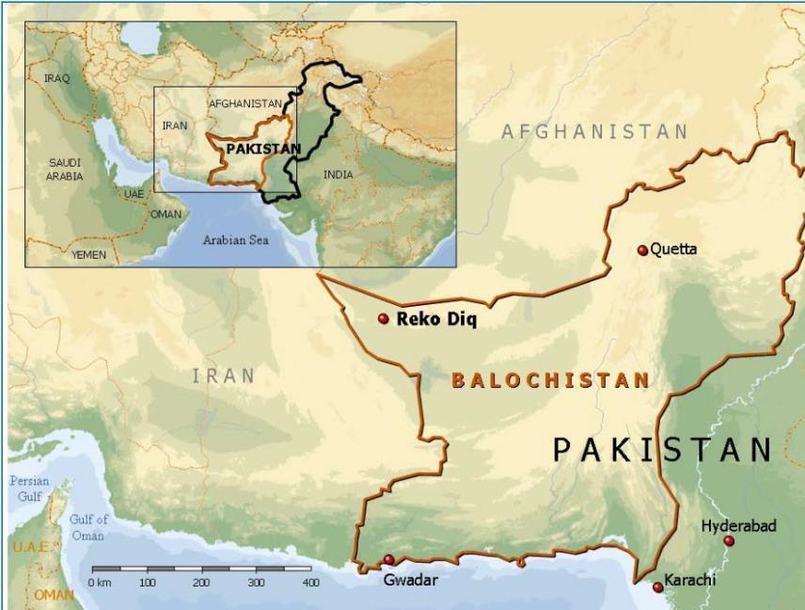
PROJECT SUMMARY
The Reko Diq Project is a Joint Venture held:
50% Barrick.
25% Province of Balochistan.
25% 3 Federal state-owned enterprises.
Updated Feasibility Study 2023-2024.
Community Development Committees already established and social development funding has already started.
Construction 2025-2028
First copper 2028
Barrick Gold Corporation - Reko Diq Copper-Gold Project (www.barrick.com/English/operations/reko-diq/default.aspx)

Slide 3
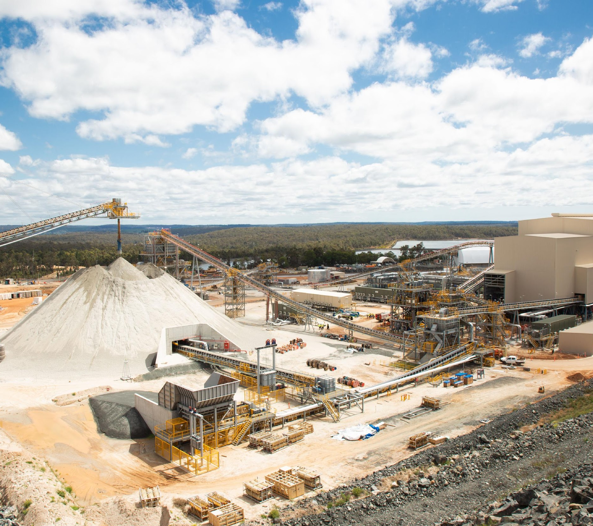
ABOUT LYCOPODIUM
Lycopodium is an innovative and value-driven process, engineering and project delivery organisation.
Lycopodium Minerals Pty Ltd (Company Representative) is the EPCM Contractor for the Reko Diq Copper Gold Project (Project), acting as agent for and on behalf of Reko Diq Mining Company (Company).

Slide 4
REQUEST FOR TENDER (RFT)
Your company might be selected to participate in a Request for Tender opportunity on the Reko Diq Project.
This document has been developed to provide simple guidance on the Request for Tender process.
Please understand the Code of Conduct:
Code of Conduct:
One of Barrick’s core values, “Be honest, transparent and act with integrity” is translated into our Code of Conduct and other policies
This applies to all our external dealings including those with our vendors
We only engage in ethical business practices, free from corruption, and insist that our dealings with all parties be transparent, ethical and lawful
We only accept any gifts from actual or potential business partners where doing so will not be seen to impair our ability to perform our duties in a fair and unbiased manner

Slide 5
REQUEST FOR TENDER (RFT)
The Request for Tender process is formal.
This means the mode of communication is via email to a nominated Representative (from Lycopodium).
To understand if your company is interested in receiving a Request for Tender, an initial email from Lycopodium will be emailed to your company.
Please ensure your company responds to this email outlining if your company is interested in receiving the Request for Tender.
Where possible, Lycopodium or RDMC may attempt to follow up non-responses to this request via telephone.
A formal clarification register is provided with the Request for Tender. Please use this form for any queries to the nominated Representative.

Slide 6
REQUEST FOR TENDER (RFT)
Please ensure timeframes for responding to a Request for Tender are understood and followed.
Your company is able to ask questions to the nominated Representative via email submitting the formal clarification register.
To ensure a fair process if followed, all information needs to be shared to all bidders.
Please be patient in awaiting a response from the nominated Representative. A typical response time is 2 to 3 business days.
It is very important to follow the timeframes in the RFT, especially the closing date!
Your company is also able to register as an interested company by emailing with a summary of your company’s expertise.

Slide 7
EVALUATION OF TENDER
Note to Tenderers
Full Instructions as to what documents required in Tender submission is in Request for Tender pack.
(Note the importance of submitting all supporting documents with tender submission).
Selection of the prospective contractor is subject to strict evaluation criteria.
Tender Price is not the only criteria for selection.
Example Evaluation Criteria:
Commercial | Technical | Others
Price | Proposal | QA/QC
Compliance to Contract T& Cs | Org Chart | HSE Records/ Statistics
 | Past Experience | Industrial Relations
 | Work in hand
 | Resources
 | Construction Schedule

Slide 8
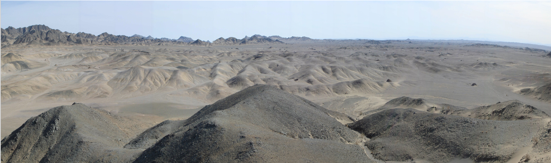
T H A N K Y O U

